Slide 1
Indian Rainfall Analysis & Prediction
Unveiling Trends and Insights
(A Data-Driven Exploration 1901-2021)
Project By: Santosh Bopche

Slide 2
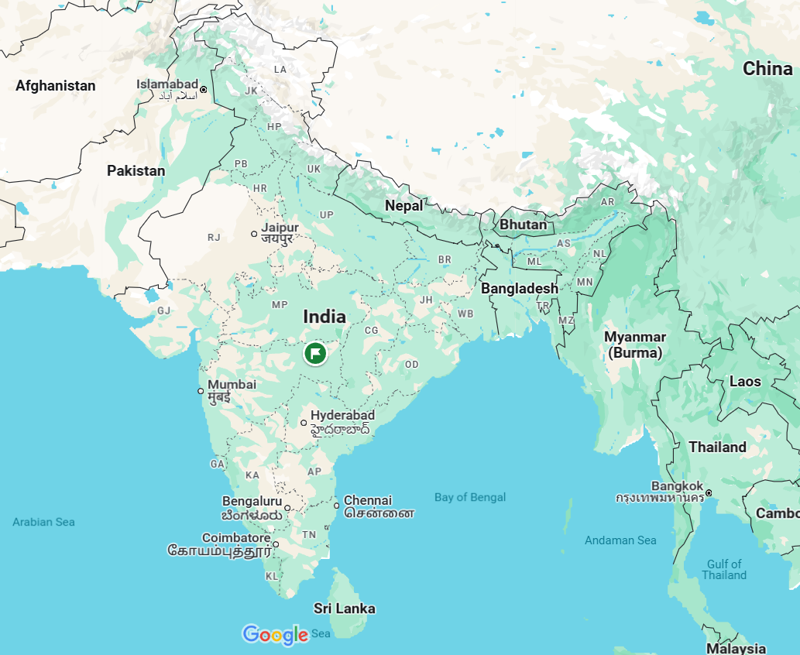
Understanding India's Monsoon: A Vital Phenomenon
Importance of rainfall for India: agriculture, economy, water resources.
Overview of the dataset: 1901-2021, covering various subdivisions.
Project objectives: Analyze historical patterns, identify regional variations, and predict future trends.

Slide 3
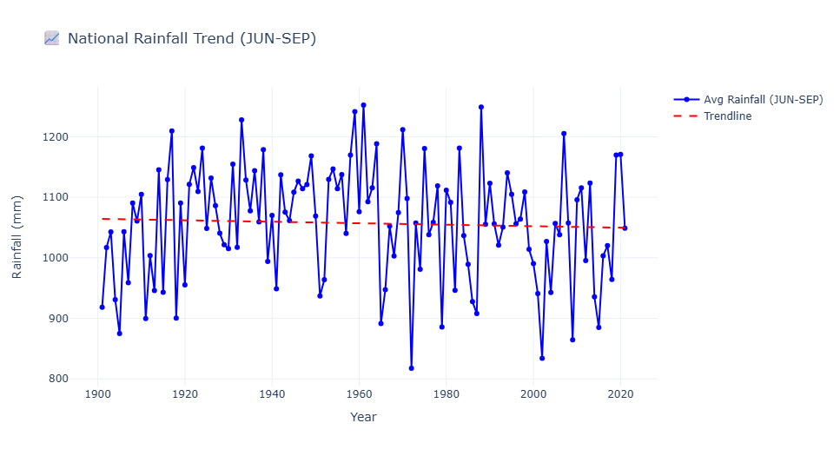
A Century's Perspective
(Source: RainFall.py; RainFall_ML.ipynb - Cell 16)
Key Insights:
No clear, consistent long-term national trend.
Significant year-to-year variability.
More extreme high/low years post-2000.
Notable recent dry years (e.g., 2002, 2015-2019).

Slide 4
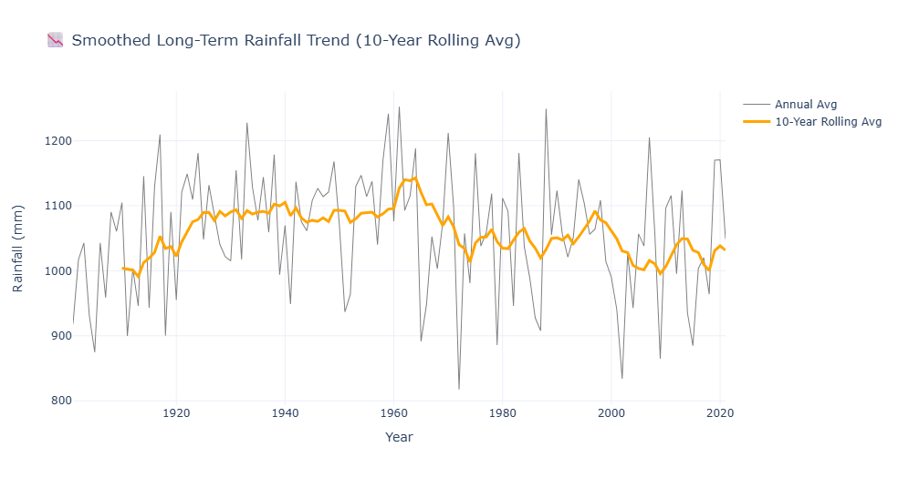
10-Year Rolling Average
(Source: RainFall_ML.ipynb - Cell 24, fig2)
Key Insights:
Rolling average smooths fluctuations, reveals decadal trends.
Peak rainfall around 1960s.
Gradual decline in rolling average post-1970s.

Slide 5
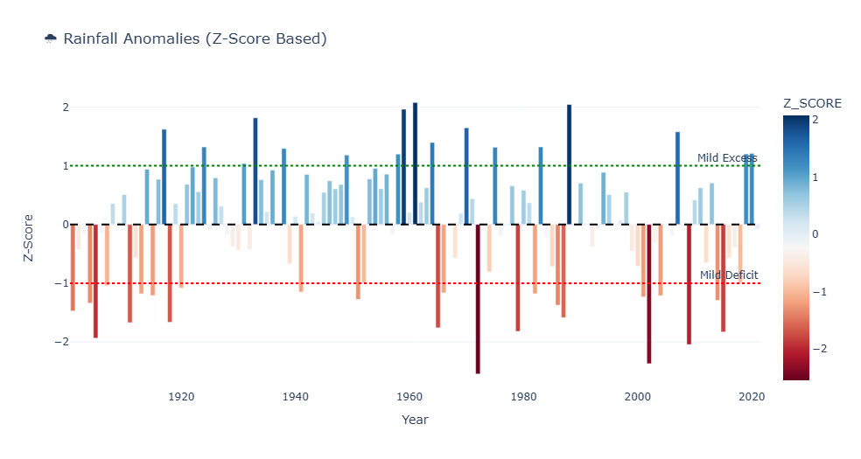
Identifying Deviations Over Time
(Source: RainFall_ML.ipynb - Cell 25, fig3)
Key Insights:
Frequent deficits post-1970s (Z-score < 0).
High excess periods (1950s-60s, late 1980s) (Z-score > 1.5).
Increasing extremes (deficits & excesses) post-2000s.

Slide 6
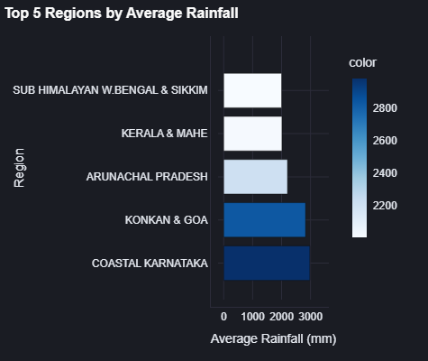
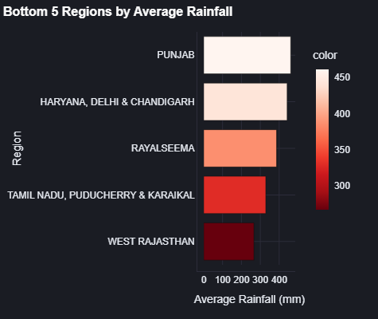
Highest & Lowest Regions
(Source: RainFall.py - Overview Page)
Key Insights:
Significant geographical variation.
Coastal/NE regions (Arunachal Pradesh, Konkan & Goa) highest.
NW/interior regions (West Rajasthan, Marathwada) lowest.

Slide 7
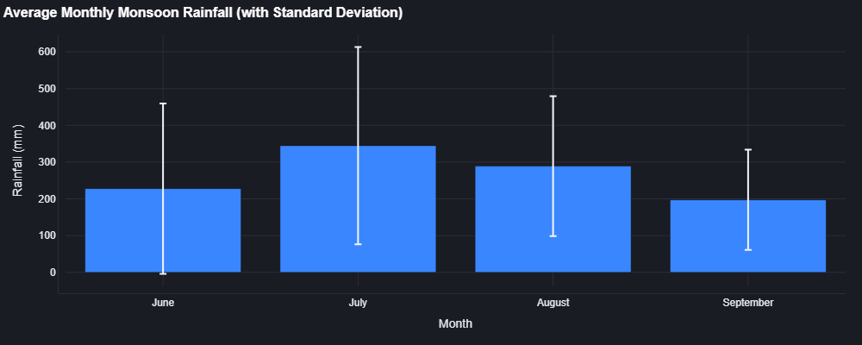
Rhythm of the Monsoon
Key Insights:
National peak: July-August.
June: onset; September: withdrawal.
Std dev highlights variability.

Slide 8
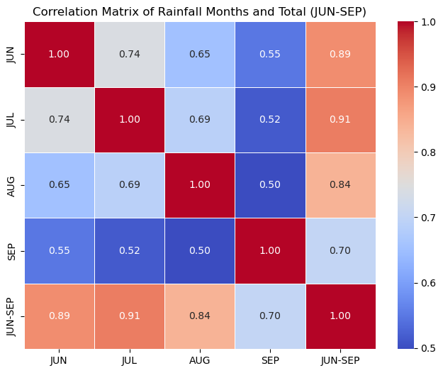
Interconnected Rains
 | Jun | Jul | Aug | Sep | Jun-Sep
Jun | 1.000 | 0.742 | 0.653 | 0.547 | 0.889
Jul | 0.742 | 1.000 | 0.689 | 0.515 | 0.907
Aug | 0.653 | 0.689 | 1.000 | 0.498 | 0.840
Sep | 0.547 | 0.515 | 0.498 | 1.000 | 0.703
Jun-Sep | 0.889 | 0.907 | 0.840 | 0.703 | 1.000
Key Insights:
Months positively correlated with total JUN-SEP rainfall.
July: highest correlation with total.
September: weaker relationship (withdrawal variability).
(Source: RainFall_ML.ipynb - Cell 20)

Slide 9
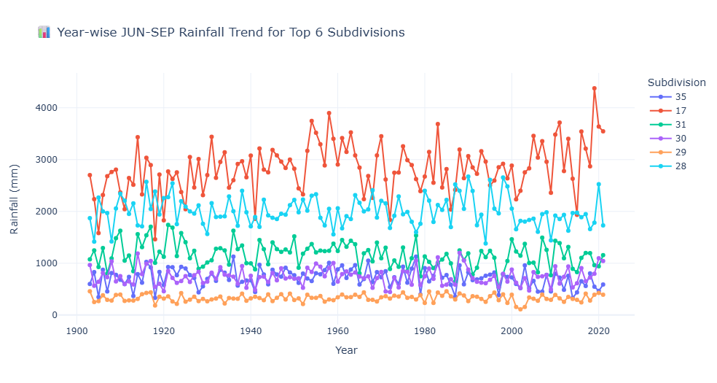
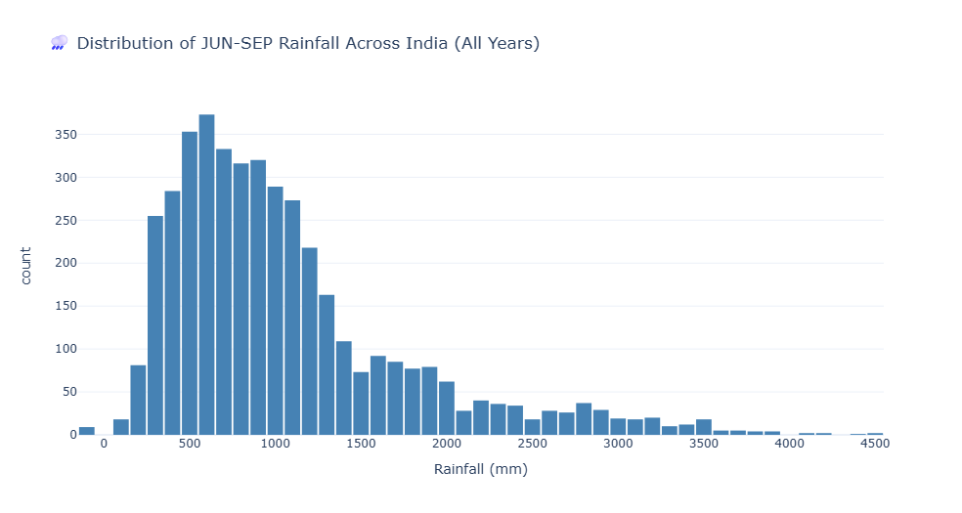
Rainfall Spread
(Source: RainFall_ML.ipynb - Cells 18 & 19)
Arunachal Pradesh (17) consistently receives the highest rainfall, with a rising trend after 2000 — potential climate intensification.
Konkan & Goa (28) has high rainfall with stable but fluctuating patterns — typical coastal monsoon behavior.
Vidarbha (31) and West Rajasthan (35) show moderate and relatively steady rainfall, with slight increases in recent years.
Madhya Maharashtra (29) and Marathwada (30) have lowest rainfall, with frequent drought-like dips — important for agriculture planning.
Most subdivisions show increased year-to-year variability, indicating possible climate instability
Most common rainfall: Majority of records fall between 500–1000 mm during JUN–SEP.
Right-skewed distribution: Indicates that high rainfall (2000+ mm) is rare but does occur in some regions.
Low rainfall events (<400 mm) are also frequent, pointing to drought-prone areas.
Significant variation: Reflects diverse climatic conditions across India's subdivisions

Slide 10
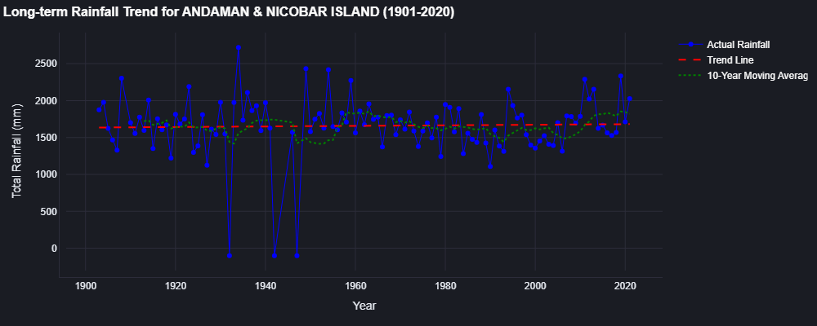
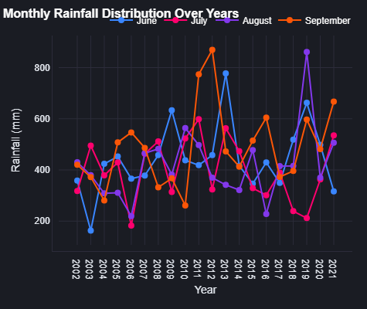
Historical Analysis
Key Insights:
Long-term trends vary by region. Moving averages show decadal patterns.
Seasonal analysis: peak months, recent shifts.

Slide 11
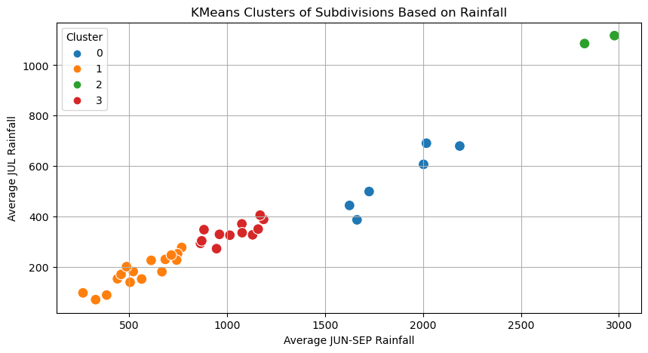
Clustering of Subdivisions Grouping by Rainfall Characteristics
Key Insights:
KMeans groups similar rainfall patterns.
Aids in targeted water resource management.

Slide 12
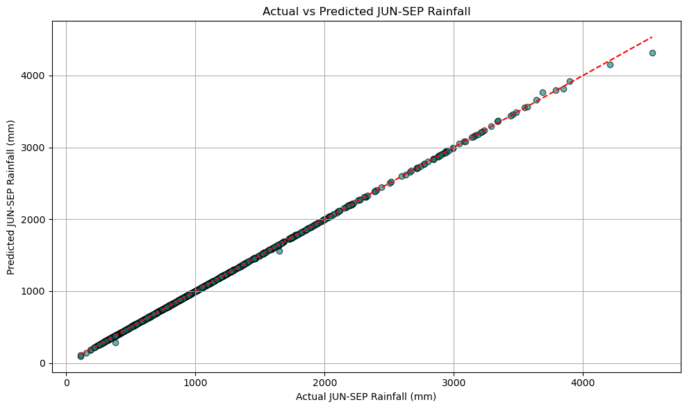
Model & Features:
Model: Random Forest Regressor.
Features: YEAR, AVG_RAINFALL, YOY_CHANGE, LAG_1, LAG_2, Sub_Division_Encoded.
Target: JUN-SEP total rainfall.
Model Performance:
R² Score: ~99.98%
MAE: ~1.53 mm
RMSE: ~9.55 mm
Insight: High accuracy on historical test data.
(Source: RainFall_ML.ipynb - Cell 22 & Streamlit)

Slide 13
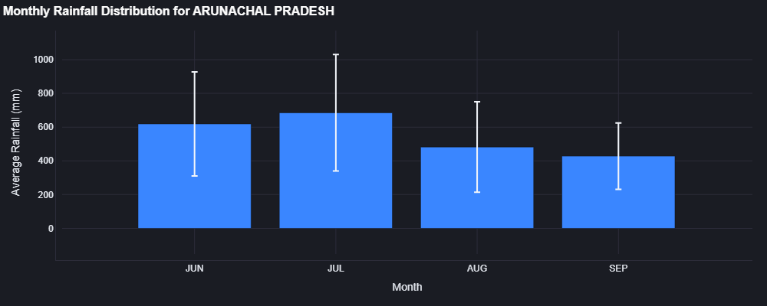
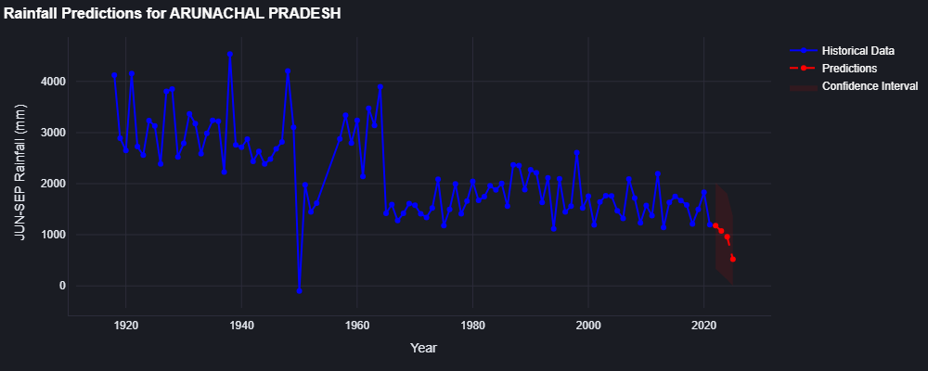
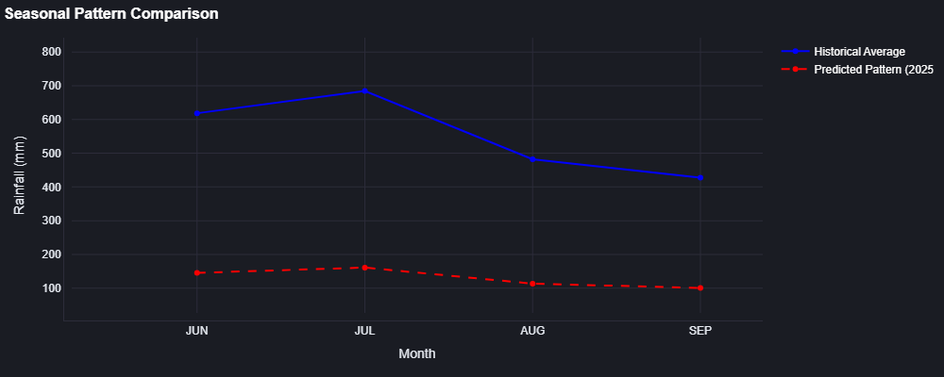
Rainfall Prediction Dashboard Selected Region

Slide 14
Conclusion & Key Takeaways Synthesizing the Findings
Summary of Main Insights:
National rainfall: high variability, no strong trend; recent decades more extremes.
Regional disparities: high-rainfall vs. drought-prone.
Monthly patterns: consistent with regional nuances, some recent shifts.
July rainfall highly correlated with total monsoon.
Clustering groups regions by rainfall behavior.
ML model: high predictive accuracy.
Implications:
Need for region-specific water/agricultural strategies.
Monitor increasing climate volatility.
Predictive models aid proactive planning.

Slide 15
Thank You
Santosh Bopche
sahilbopche3@gmail.com
+91 9022264889

